Slide 1
Ultimate AI Kuhn
Dane E. Parchment Jr. | Austin Nowak | Joannier Pinales

Slide 2
Project Overview
We chose to utilize Counterfactual Regret Minimization with Chance Sampling (CFRCS) for our agent
Strategy Profiling was also employed in order to help improve performance results against other AI agents
We chose the strategies above in due its “cool factor” and also because more research could be done with CFRCS

Slide 3
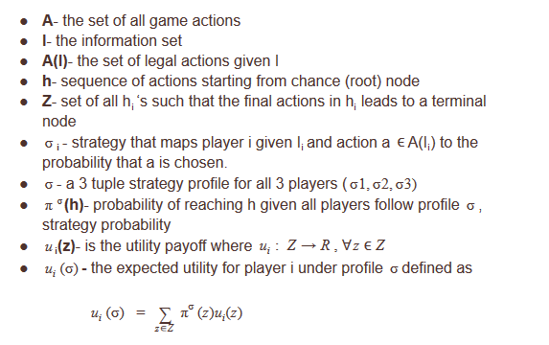
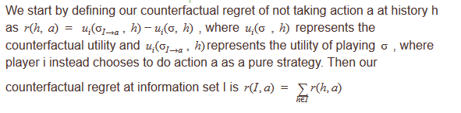

Algorithms

Slide 4
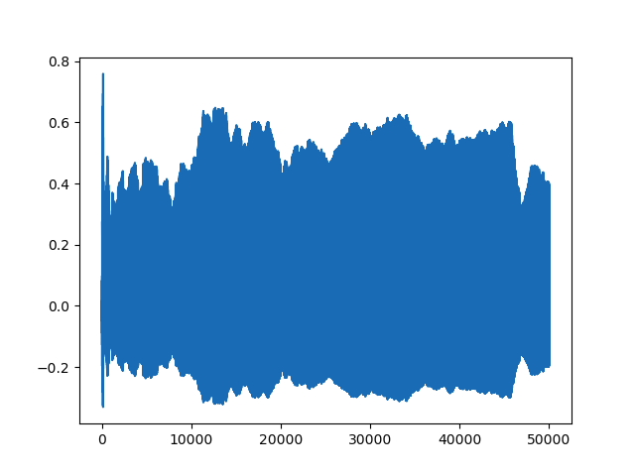
Results
Action Regret x Iteration

Slide 5
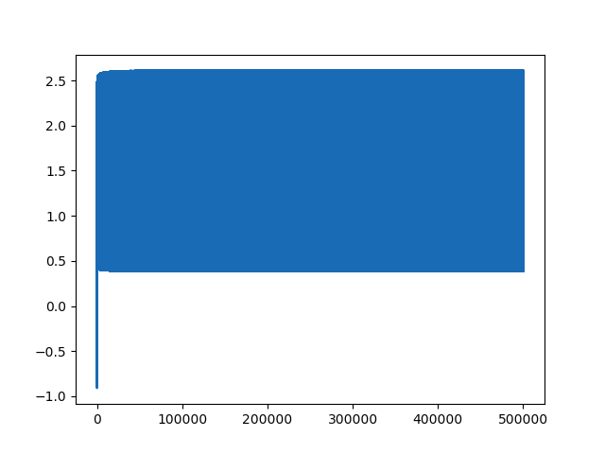
Results
Action Regret x Iteration
When played against other strategy profiles it performed the best

Slide 6
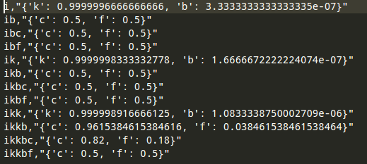
Results
Strategy Profile Created By CFR Function

